Slide 1
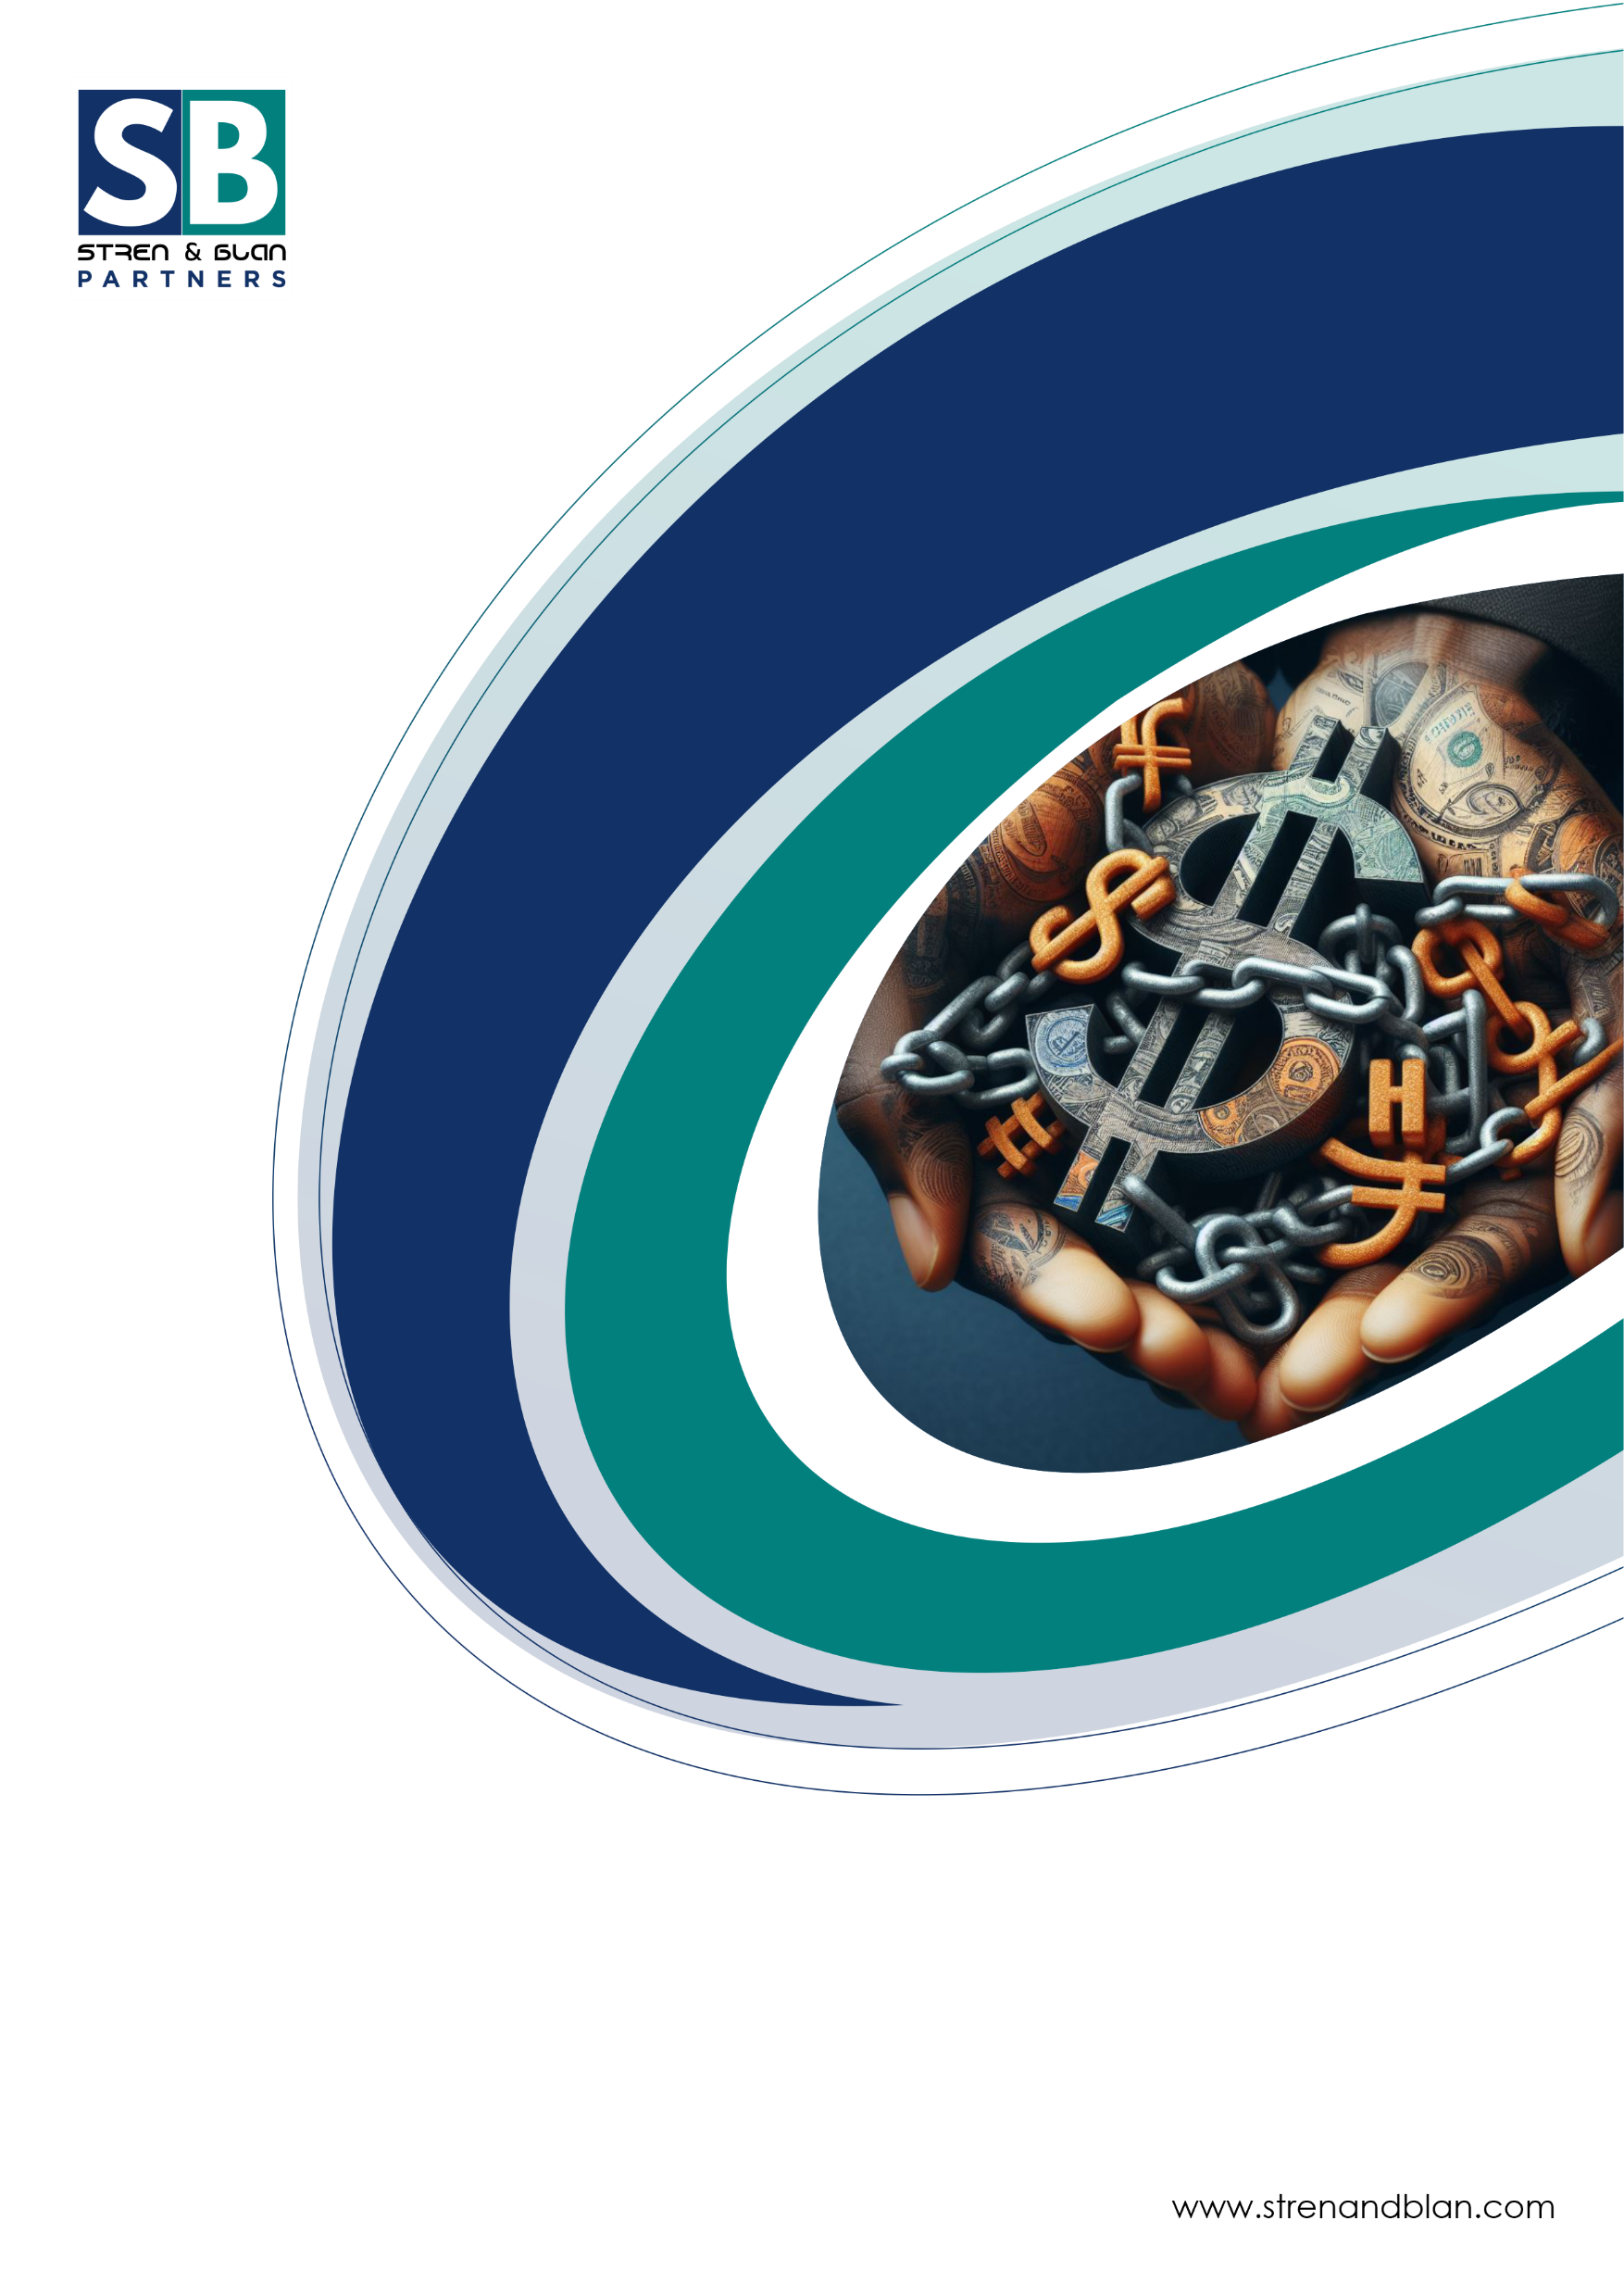
Sovereign Debt – Insights on the Year 2023 and Outlook for 2024

Slide 2

INTRODUCTION
Sovereign debt is the debt a government borrows domestically or from other governments and international financial institutions. It is backed by the power of the sovereign and is essential for a government's continued success and the implementation of its policies. The concept of sovereign or public debt is similar to individuals taking loans when they are out of money.
African governments have taken on loans to pursue various development agendas, but the impact of these debts on their economies can't be ignored. Africa has experienced a 183% surge in debt since 2010, with most of it concentrated in Northern African countries. In 2020, 27 countries surpassed the 60% debt-to-GDP threshold, with 21 low-income countries at risk of debt distress. As of 2022, Africa's public debt has soared to USD $1.8 trillion and certain African nations have a combined debt of USD $655.6 billion to external creditors.
Following the Covid-19 pandemic in 2020 and the Russia-Ukraine war in 2022, stressors which have negatively affected the global economy, the sovereign debt status of African countries has come into focus, as most African countries rely heavily on sovereign debt to facilitate government spending and economic growth. In June 2020, Zambia defaulted on its sovereign debt, becoming the first African country to default post Covid-19, and in December 2022, Ghana, an unlikely runner-up followed suit.
The United Nations has indicated that several other African countries are at a high risk of distress and may default on their loans within the short to medium term.
This paper seeks to observe and analyze the trends developing in these countries to better understand the financial predicament of the countries and advise on when a sovereign debt restructuring may be apposite to forestall a default and ensure debt stability through early detection and deployment of restructuring tools.

Slide 3
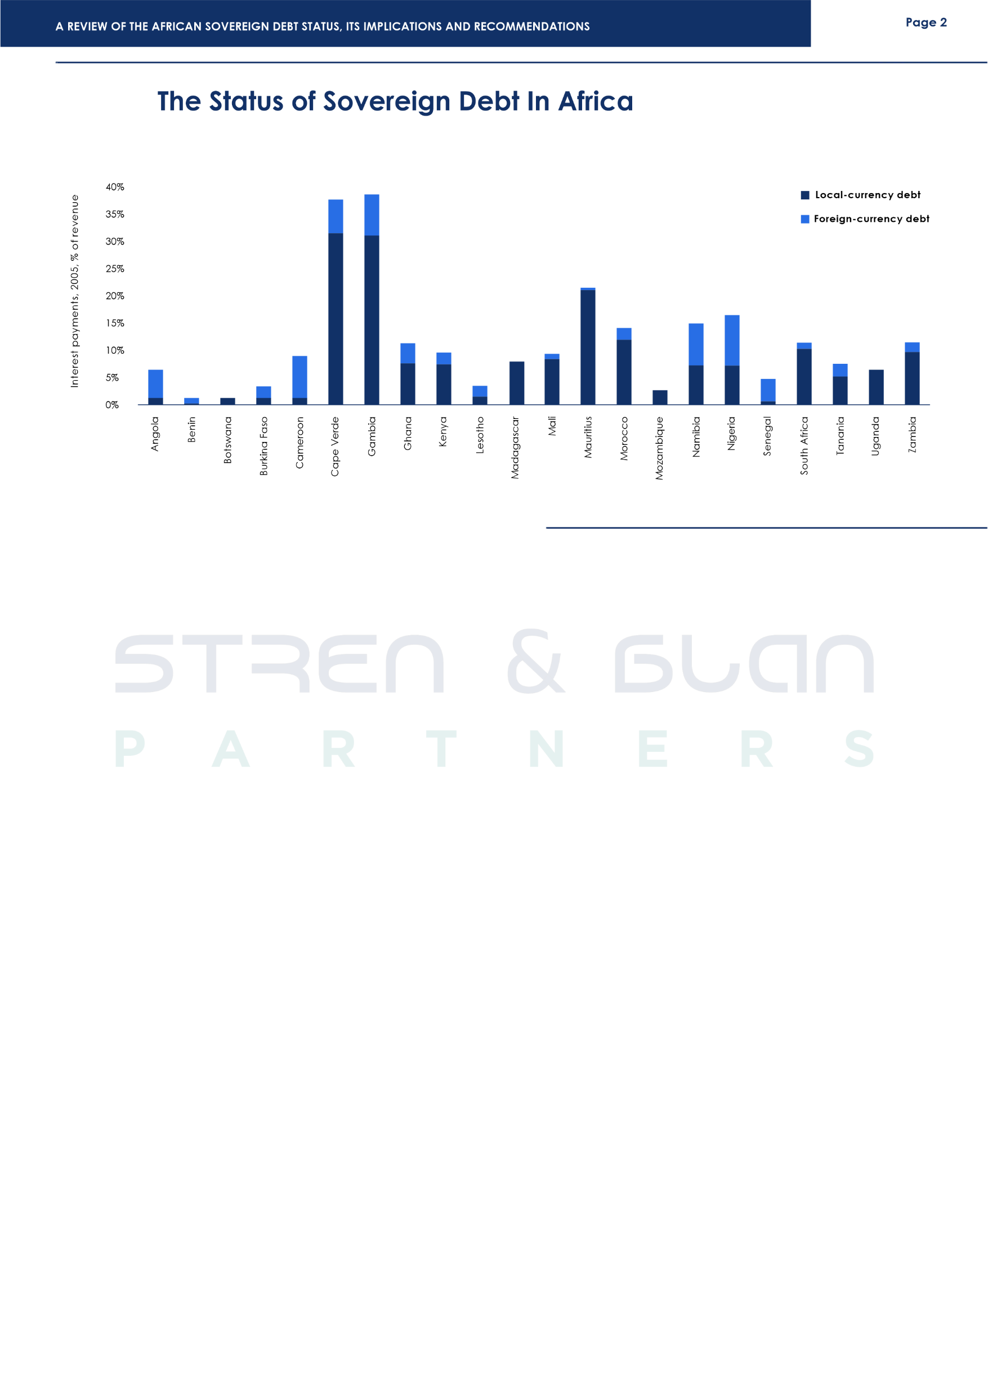
Borrowing remains a favourable option for most countries. Borrowing helps increase government spending without increasing taxes, ensuring that governments can invest in public infrastructure and improve the economy of their countries without overburdening the population with increased taxes, which is important to most African countries where tax collection and enforcement are not optimized as most citizens cannot afford to pay taxes, African countries that require funding to develop needed infrastructure for economic growth often have no other recourse than to borrow the required funds.
In 2022, the total estimated debt for Africa was $1.1 trillion, a figure that is estimated to increase by $200 billion to $1.3 trillion in 2023. The increase was caused by several factors, primarily the negative effect of the COVID-19 pandemic on the global economy and the rising food and energy costs due to the Russia-Ukraine war. Along with the increase in debt, there has also been an increase in interest rates thereby making it more expensive to borrow money and ultimately increasing the cost of debt servicing. Debt servicing payments increased from $21.2 billion in 2022 to $22.3 billion in 2023.
In anticipation of sovereign debt defaults as a fallout of the pandemic, the Group of 20 (G20) in late 2020, developed the G20 Common Framework on Debt, a measure that was intended to speed up the process of providing debt relief to distressed countries. So far, four African countries have applied for debt reliefs under the Common Framework: Zambia, Ghana, Chad and Ethiopia. Our discussion will focus on them as well as five other African countries, South Africa, Egypt, Central African Republic, Sudan, Somalia and Nigeria.

Slide 4
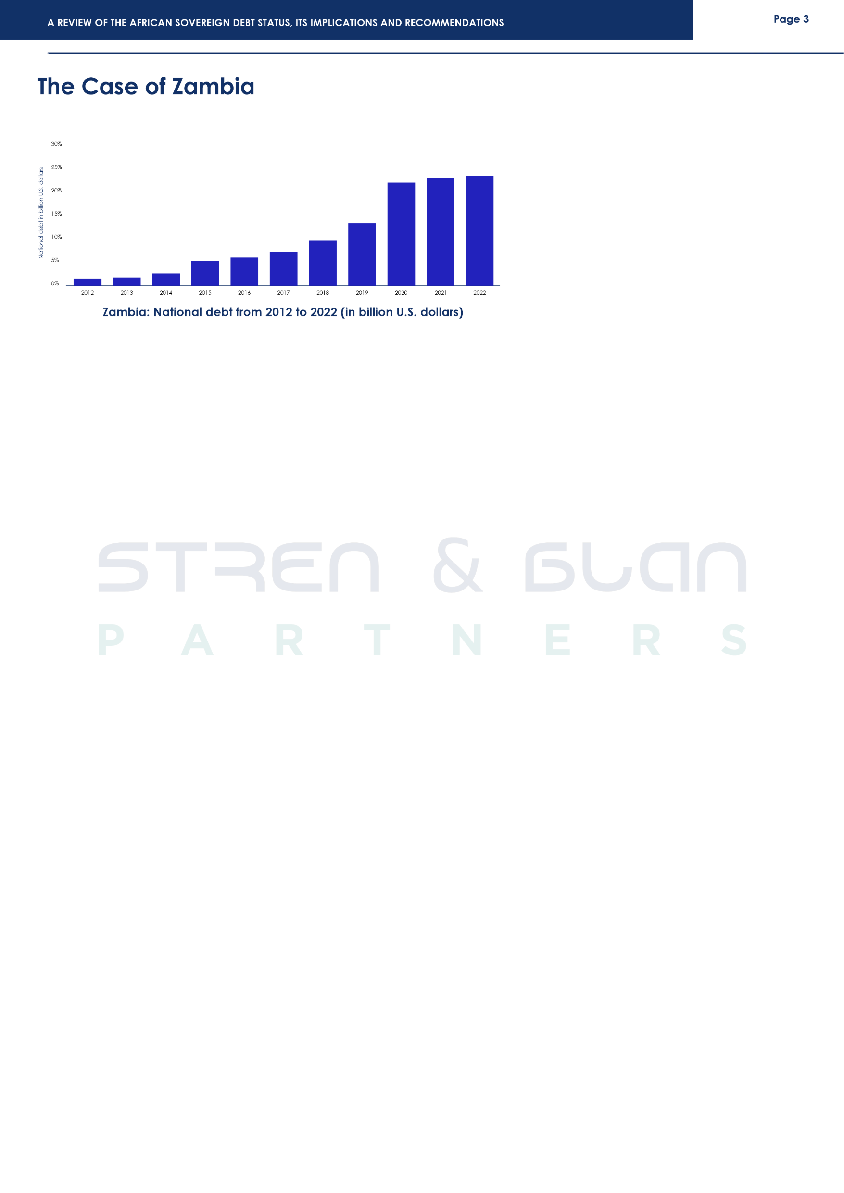
On 13th November 2020, Zambia became the first African country to default on its debt.
As at end of June 2021, Zambia’s public debt stood at $29.6 billion. Official sources cite as the reason for the default; higher poverty rates, adverse climate changes (particularly the drought that hit the country in 2015)¹, and inefficient public investment drive worsened by the COVID-19
pandemic and the Russia-Ukraine war.²
The Zambian government first sought debt suspension under the G20 Debt Service Suspension Initiative (DSSI) which was introduced in 2020 to enable countries to focus on funnelling resources into managing the pandemic instead of debt service repayments. As the name suggests, the DSSI only suspended the debts and did not include a restructuring agreement. As a result, the Paris Club only agreed to suspend Zambia's debt service payment from 1st May to December 2020. However, in November 2020, the Zambian government missed a coupon payment of $42.5 million on its 2024 Eurobond, marking its default on its sovereign debt.³
On 1st February 2021, Zambia officially requested for a debt restructuring/treatment under the G20 Common Framework. Three years after its default, and two years after its official request, Zambia has still not reached a debt restructuring agreement. The Paris Club suggested that China, Zambia's biggest bilateral creditor, has been less than forthcoming. China's philosophy for debt restructuring differs from the traditional Western creditors. While other creditors prioritize debt forgiveness, China prefers an extension of the period for repayment. While the International Monetary Fund has approved $1.3 billion Extended Credit Facility (ECF) to Zambia, the country needs to reach an agreement with its external creditors to continue receiving the funds. More recently, Zambia's official creditors have rejected the proposed debt restructuring agreement, stating that the deal was too generous for private bondholders. Therefore, Zambia continues to grapple with its debt crisis.⁴
¹The Road to Zambia’s 2020 Default (findevlab.org)
²A Tale of 3 Nations: Debt Restructuring in Ghana, Zambia, and Sri Lanka The Diplomat
³Zambia to default on foreign debt, finance minister says | Debt News | Al Jazeera
⁴Zambia’s debt restructuring derailed after official creditors reject deal

Slide 5
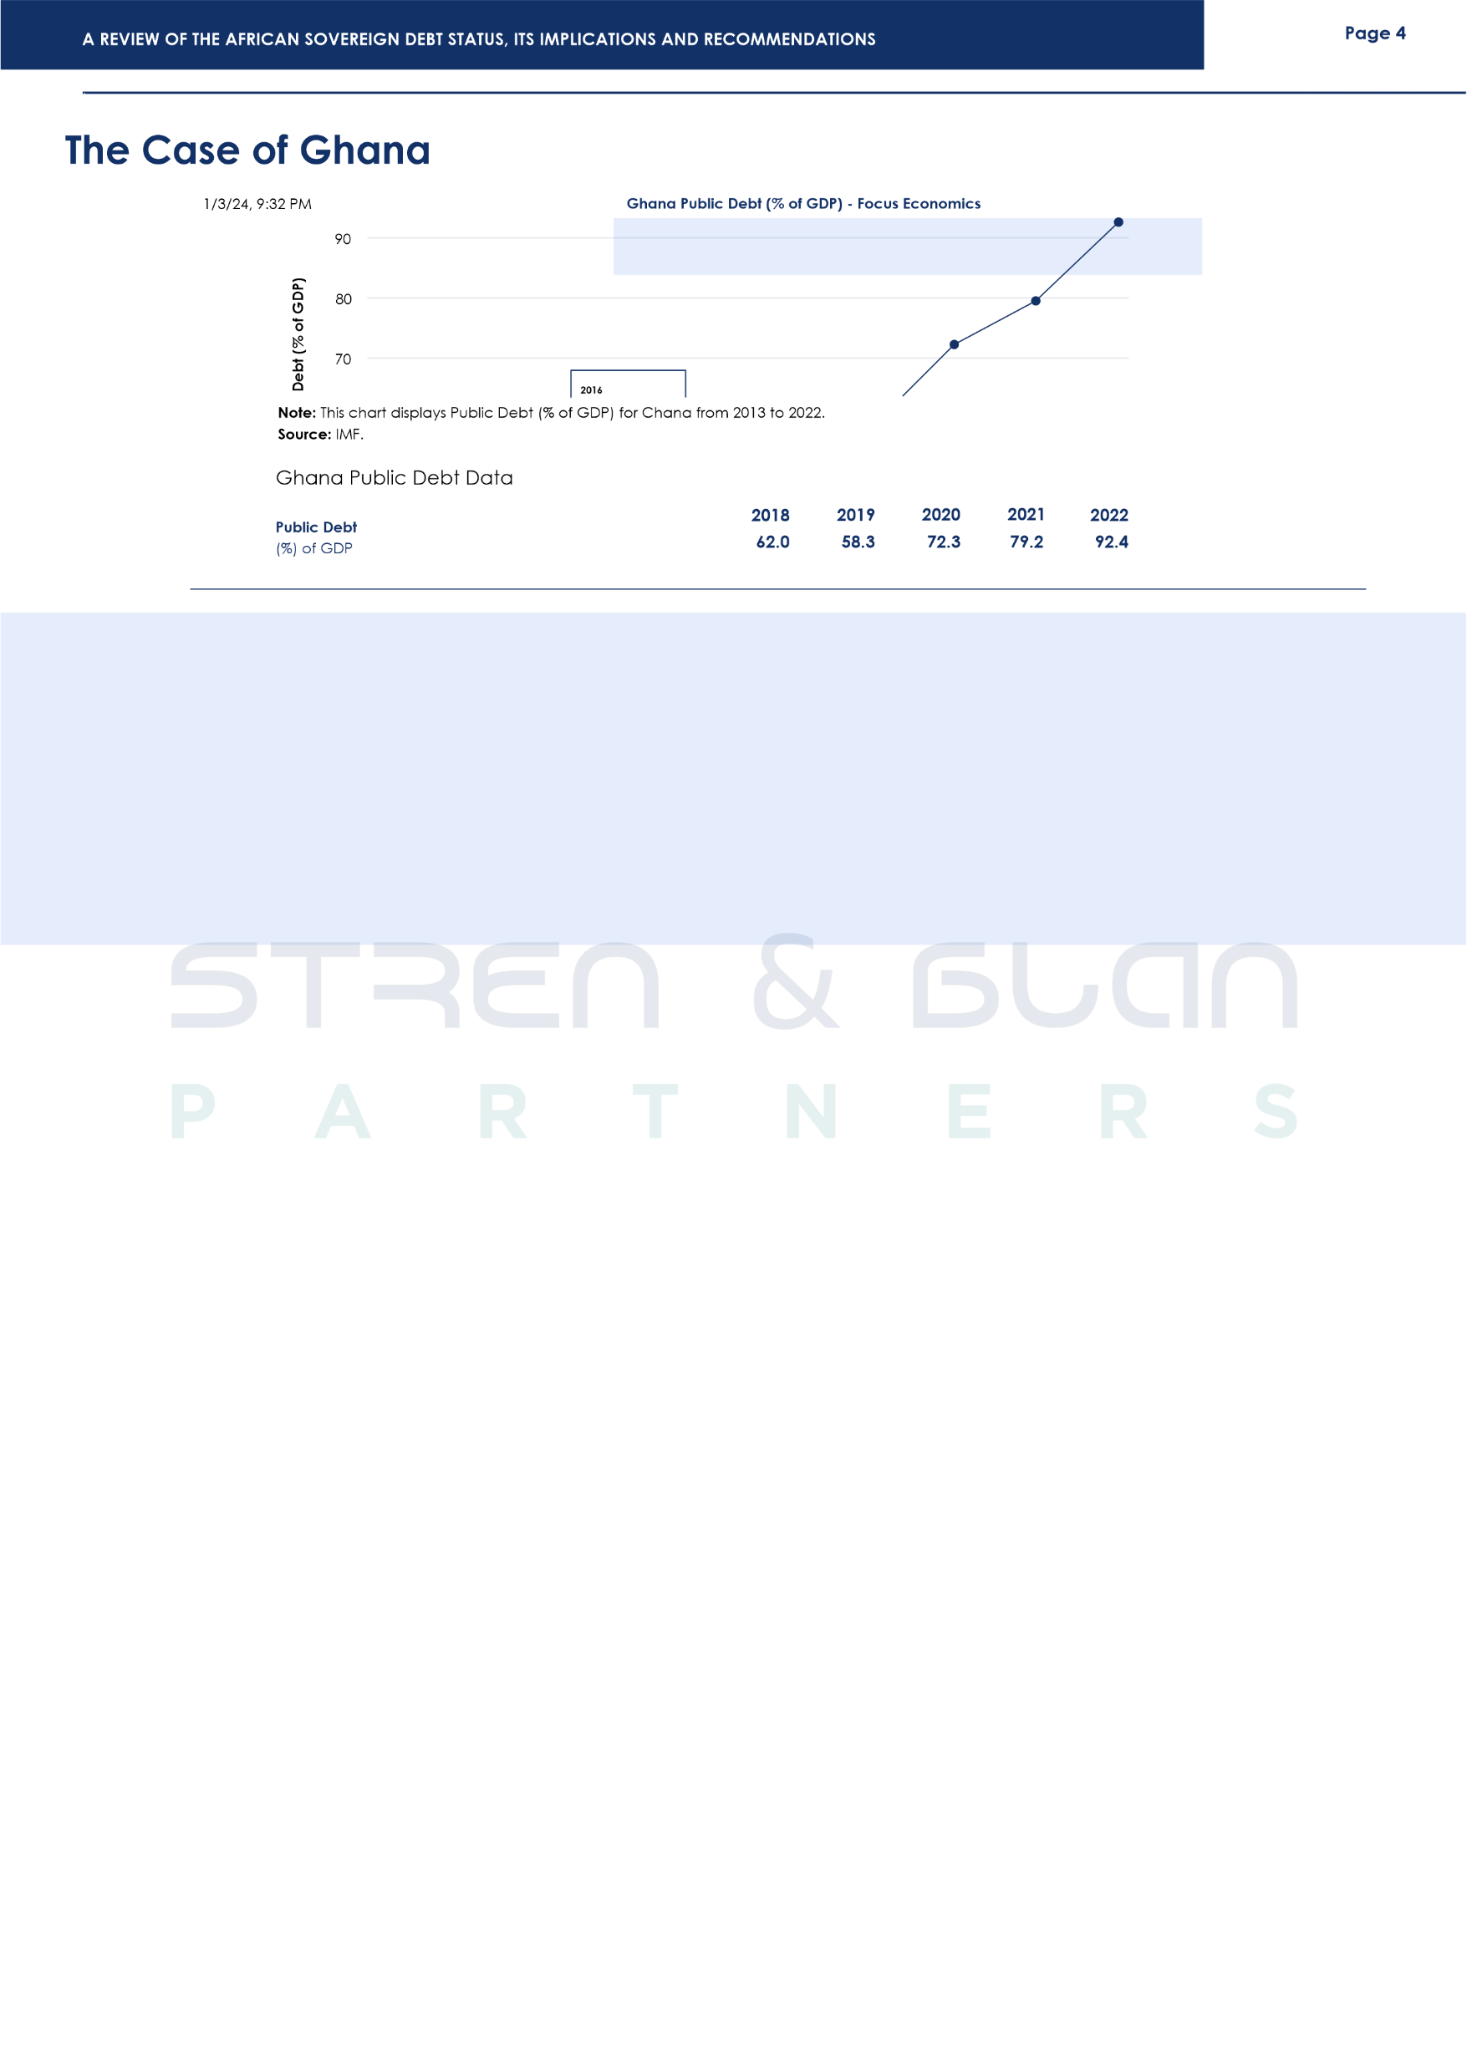
Ghana’s dependence on commodities has remained a central theme of much of the country's debt crisis, its economy remained largely dependent on the export of three primary commodities – cocoa, gold and oil which it began to produce and export in 2011. The boom in the price of cocoa and gold in the early 2000's led to a booming economy. This remarkable growth led to an increase in the willingness and desire of various institutions to lend money to Ghana, which the government acted upon, making huge borrowings under the expectation of commodity price booms or low interest rates.
In a report by the IMF, in 2021 Ghana's Public debt rose from 79.6% to over 90% of GDP in 2022, as debt service-to-revenue reached 117.6%. According to the Ghanaian Ministry of Finance, the country's domestic debt portfolio at the end of 2022 stood at approximately GHS 259.2bn, while its external debt was in the sum of USD $30.5bn⁵.
Ghana defaulted on its external debts in December 2022. Ghana approached the IMF for a USD $3 billion bailout, however, the IMF required Ghana to address its domestic debt which made up about 45.7% of its GDP.
On 5th December 2022, the Government of Ghana launched Ghana's Domestic Debt Exchange programme, an invitation for the voluntary exchange of approximately GHS137 billion of the domestic notes and bonds of the Republic. The Domestic Debt Exchange Program (DDEP) was initially closed on Friday 10th February 2023 with the Ministry of Finance reporting over 80% participation of eligible bonds. The government finalized the program in September 2023.
Having fulfilled the conditions for the USD $3 billion bailout by the IMF including gaining financing assurances from its official creditors, by 17th May, 2023, the executive board of the International Monetary Fund had approved the USD $3 billion, three-year loan program for Ghana, allowing for an immediate pay-out of roughly USD $600 million, the release of further funds after the IMF has conducted reviews, and potentially providing a way out of the biggest economic crisis the West African nation has experienced in a generation. Ghana is currently seeking to restructure its debt under the G20 Common Framework, seeking to restructure its $5.4 billion debt owed to bilateral official creditors.
At the time of publishing this report the Ghanaian Ministry of Finance on 12th January, 2024 announced that Ghana had reached an agreement with its Official Creditors under the G20 Common Framework, on a comprehensive Debt Treatment Beyond the Debt Service Suspension Initiative.
⁵Republic of Ghana: Investor Presentation.” Ministry of Finance of the Republic of Ghana.

Slide 6
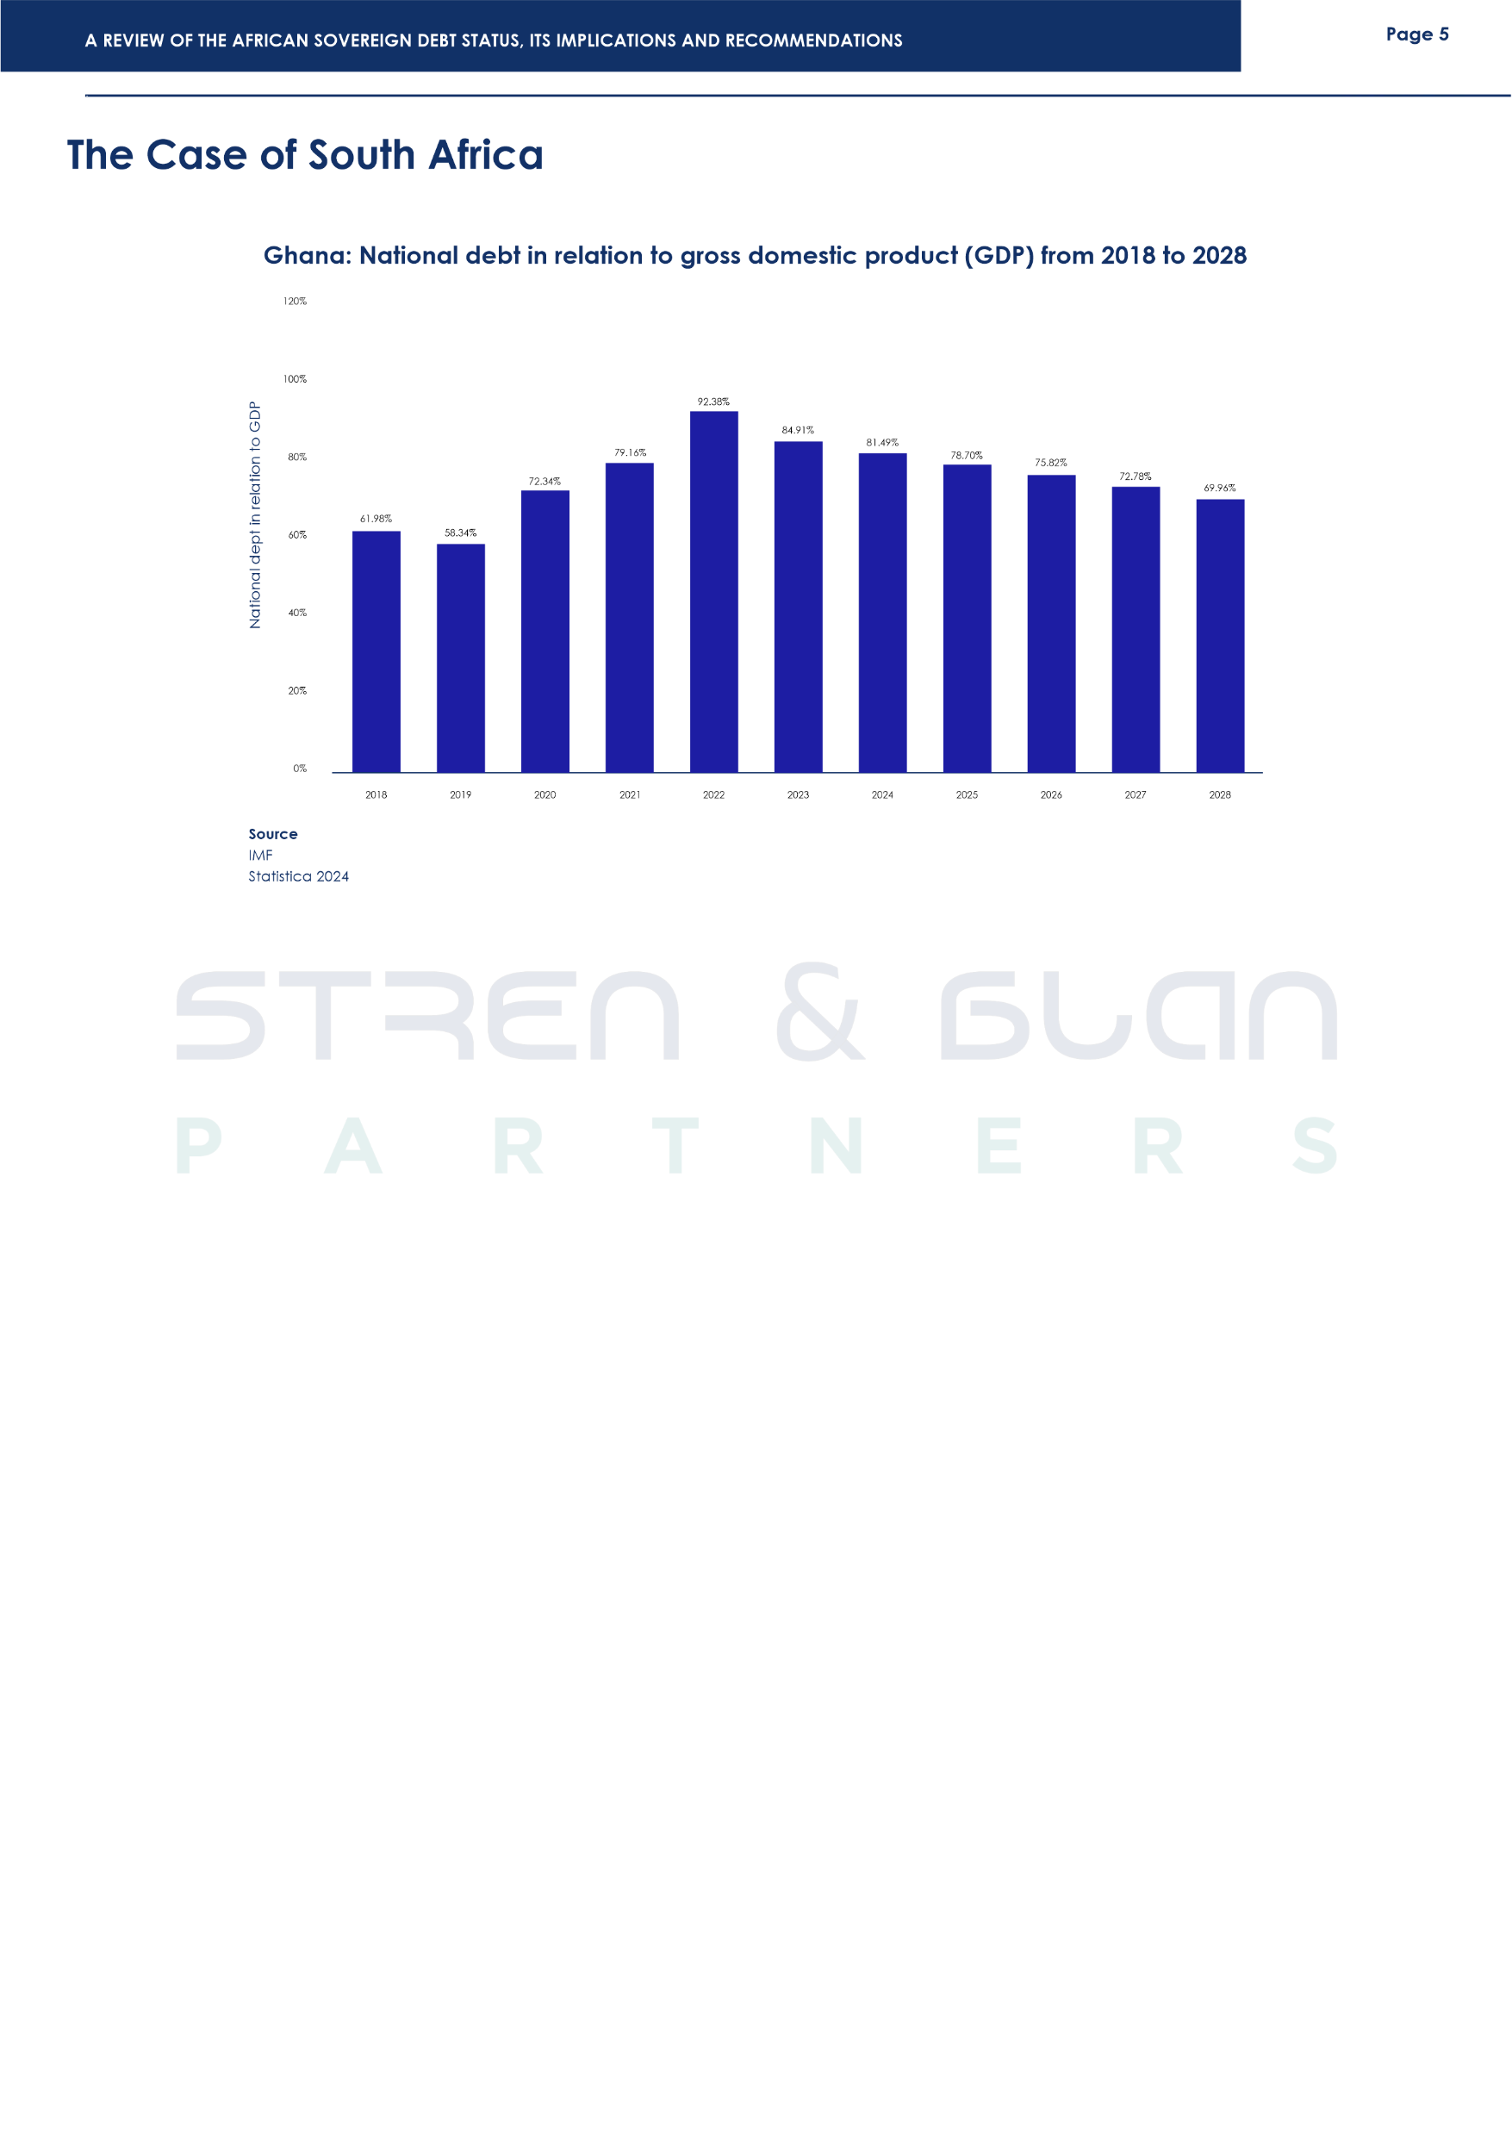
South Africa's debt portfolio has a substantial and growing debt burden. Government debt in South Africa was estimated to average 54.1% of GDP in the decade to 2022, above the Sub-Saharan Africa average of 43.7% of GDP. As of 2022, the nation's debt load has risen dramatically to roughly 71% of GDP.⁶ Being one of the most indebted nations in the area, South Africa is now at greater risk of a sovereign debt crisis due to its increasing debt load. According to Aaron, the national debt of South Africa is projected to increase to a new peak of 435.46 billion U.S. dollars in 2028.⁷ The country's debt is composed of private and public borrowings. The region's debt portfolio has also changed, with a notable rise in private sector financing, which currently makes up roughly 19% of the region's overall debt. The government of South Africa is still collaborating with the private sector to expand the nation's capital markets and guarantee a diverse range of financial instruments, even if the country's foreign debt still makes up a small portion of its total borrowings. The objective of the South African government is to fund its borrowing needs at the lowest feasible cost, utilizing a range of measures that allow it to identify the optimal combination of debt instruments and minimize the risks associated with refinancing, currency fluctuations, and overall borrowing expenses.⁸
According to the World Bank, the debt burden of the South African government has negative implications for the country's economic growth and stability. Moreover, it has been estimated that the swelling country's debt ratio has the capacity to create a crowding-out effect that hampers the growth of an economy that is already characterized by high poverty rate, inflation, and serious unemployment.
⁶Focus Economics, “South Africa Public Debt”, accessed 14 December 2023.
⁷O. Aaron, 'South Africa: National debt from 2018 to 2028’, (November 23, 2023) accessed 14 December 2023.
⁸International Monetary Fund African Department, 'South Africa: 2023 Article IV Consultation-Press Release; Staff Report; and Statement by the Executive Director for South Africa', International Monetary Fund 2023(194) accessed 14 December 2023.

Slide 7
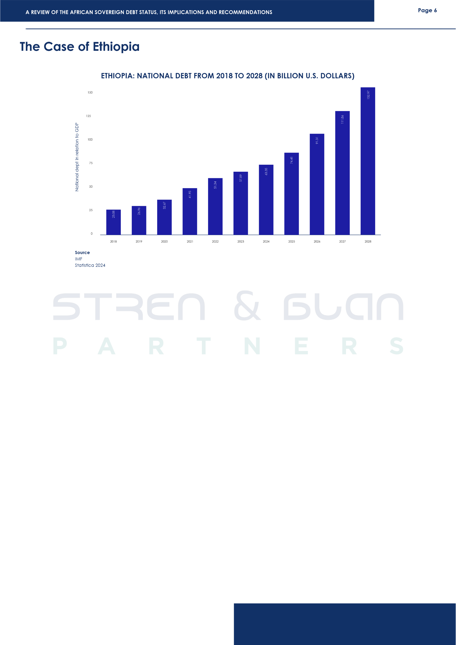
Ethiopia became the third African nation to default on its debt on 12th December 2023 when it failed to pay a USD $33 million coupon payment on its only international bond.⁹ Ethiopia, unlike Ghana, had anticipated that it would default on its debt payment and had announced its intention to default prior to the formal default.¹⁰ Ethiopia had also initially sought debt rework under the G20 Common Framework in early 2021, but talks were delayed by the civil war which only ended in November 2022 following a truce.¹¹
The war, however, worsened the already failing Ethiopian economy by causing inflation to reach double digits and causing significant shortages in Ethiopian foreign reserves.
Interestingly, Ethiopia's bilateral creditors, including China, have reached an agreement in principle to suspend the debt service payments until 2025, and restructure its USD $1 billion eurobond maturing in 2024. However, parallel talks with pension funds and other private creditors have stalled. In addition to this, the Paris Club has also stated that if Ethiopia fails to secure a staff-level agreement with the IMF before March 31, the official creditor committee of the Paris Club reserve the right to declare the suspension null and void.¹²
⁹Ethiopia defaults on $33 Million bond payment | Africanews
¹⁰Ibid
¹¹Ethiopia defaults on sovereign debt after deadline expires on $33mn payment
12 Ethiopia debt Service pause contingent on IMF deal by end-March-Paris Club | Reuters.

Slide 8
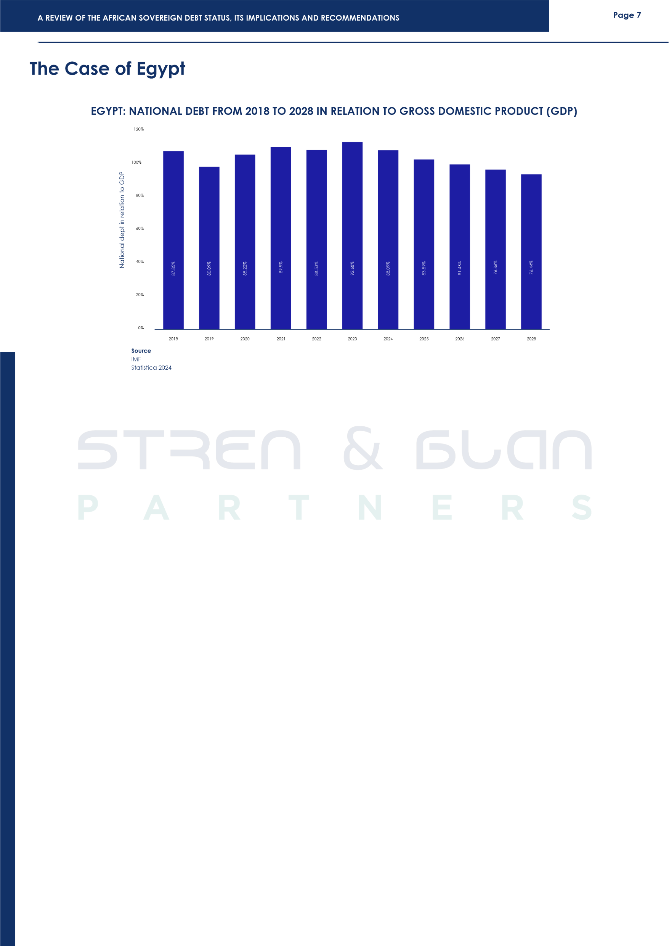
Sovereign debt represents a serious problem in Egypt. With a staggering USD 421 billion in public debt, Egypt faced a significant challenge in 2021 as over 75% of its wheat imports were reliant on Russia and Ukraine. This heavy dependency, coupled with the existing high debt burden, has constrained Egypt's capacity to consistently secure vital food and other imported commodities. The Egyptian national debt is estimated to increase in 2028 by an estimated 715.89 billion US dollars.¹³ Similarly, a particular commentator estimated that the future of the Egyptian economy is characterized by an upward increase in public debt and an increase in the standard of living.¹⁴
The country's debt portfolio includes a considerable amount of domestic debt, with a significant portion held by local banks and pensions, making its inclusion in any potential debt restructuring particularly complex. Over the past 8 years, external loans to Egypt have quadrupled, resulting in difficulty raising cash for foreign debt repayments.¹⁵ This critical level of debt reflects the long-standing macroeconomic and fiscal imbalances in Egypt.¹⁶
The Egyptian economy is characterized by stagnation, and one of the major contributors to this stagnation is its foreign liabilities. To meet its commitments to its foreign liabilities, the government has decided to sell some of its assets.¹⁷ According to Moody's Analytics, the Egyptian Central Bank data showed that $2.49 billion in short-term debt is due in June 2023, and $3.86 billion in short-term borrowing and $11.38 billion in longer-term debt are due in the second half of 2023.¹⁸ What is more, these debt requirements put an already struggling Egyptian economy into even more different problems. One of the reasons behind the rising debt in Egypt is the increase in public expenditure at an accelerating rate more than revenue.¹⁹
¹³O Aaron, ‘Egypt: National debt from 2018 to 2028’, ( november 3 2023) accessed 14 December 2023.
¹⁴Mohamed, H.’Egypt to lower public debt to 80% by 2020: Finance Min. Egypt today, (2018) accessed 14 December 2023.
¹⁵Patrick Werr, “Egypt faces external debt reckoning after borrowing spree” (June 6 2023) accessed 14 December 2023.
¹⁶Mohammed, I., Abdu. “Dealing with Egypt Public Debt Accumulation Problem”, (2019) 9(4) Business and Economic Research, accessed 14 December 2023.
¹⁷ibid.
¹⁸ibid.
¹⁹Amal, Soliman, ElGhouty. “Public Debt and Economic Growth in Egypt”, (2018) 8(3) Business and Economic Research accessed 14December 2023.

Slide 9
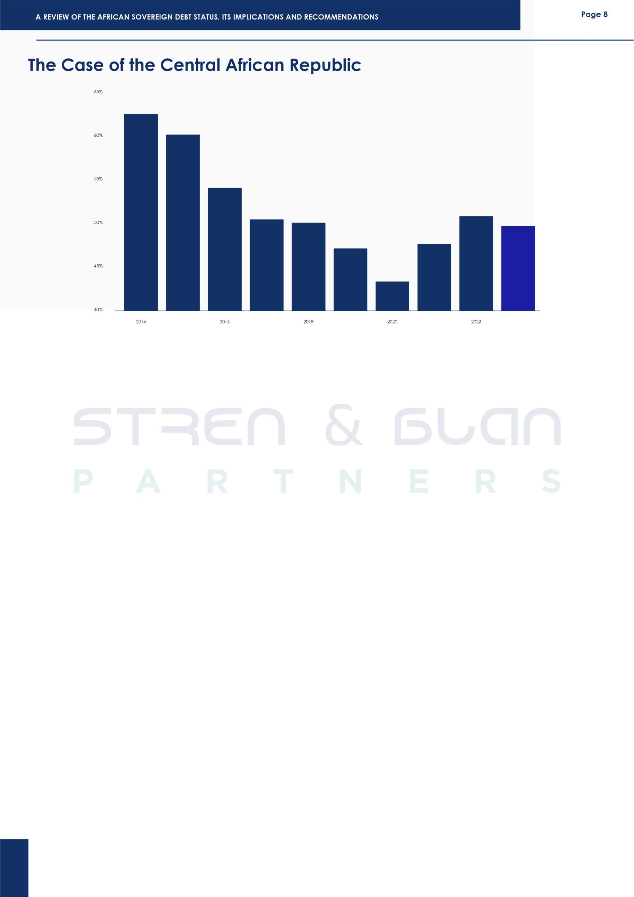
The debt load of the Central African Republic (CAR) is significant and has been increasing over time. The public debt of the Central African Republic rose 49.0% of GDP in 2022, which is up from 47.8% in 2021.²⁰ Accordingly, it has been estimated that the national debt will rise to 1.47 billion U.S. dollars in 2028.²¹ These debts put the country under serious financial distress. The economy of the Central African Republic is characterized by economic stagnation. According to the World Bank, the economy of CAR, with only 0.5 per cent growth in 2022, was the third year of economic stagnation and declining per capita incomes.²² The condition of the country is exasperated by serious political instability and the prevalence of poverty. These factors contribute to the instability in the CAR's economy.
In a nutshell, global financial architecture, political stability, and economic performance are some of the elements that affect the debt portfolio of the Central African Republic. The nation's debt load affects economic growth and stability. Thus, politicians and investors must pay close attention to this issue.
²⁰African Development Bank Group, “Central African Republic Economic Outlook”, accessed 14 Decemebr 2023.
²¹O Aaron, ‘Central African Republic: National debt from 2018 to 2028’, (October 13 2023) accessed 14 December 2023.
²²World Bank, “Central Africa Republic” accessed 14 December 2023.

Slide 10
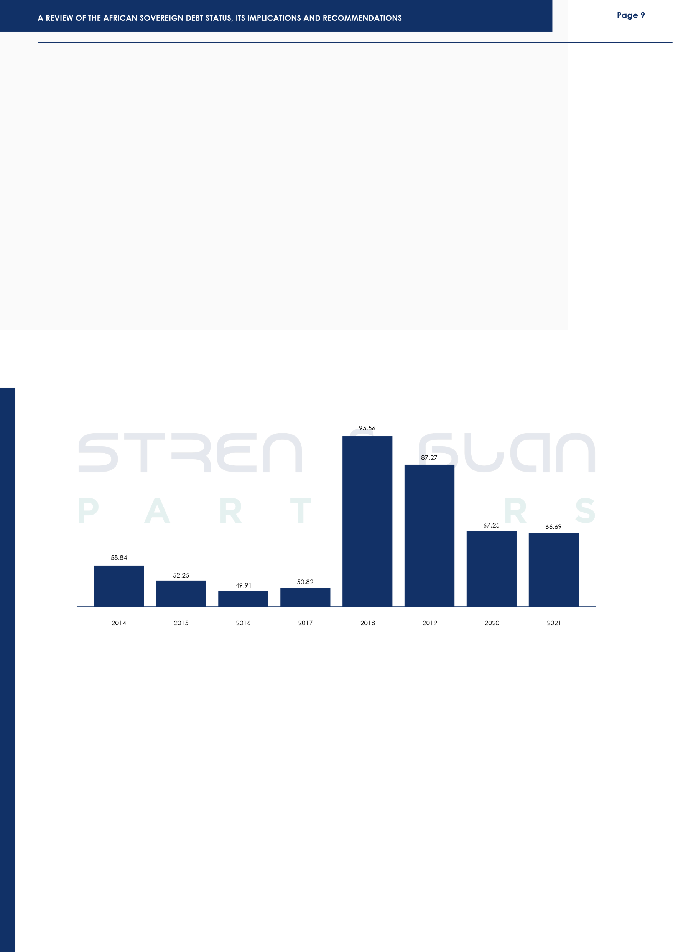
The Case of Sudan
Sudan has an overwhelming debt burden. As of 2020, Sudan's external debt was estimated at $56 billion, amounting to 163% of its GDP.²³ By 2021, Sudan’s external Debt accounted for 202.2 % of the country's Nominal GDP.²⁴ There are several reasons for Sudan's growing debt load, including political unrest and poor economic management. For example, upon the secession of South Sudan in 2011, Sudan lost a large amount of its oil production and the money that came with it, which was the nation's main source of income.²⁵ The loss of South Sudan also had negative effects on Sudan's foreign exchange reserves and also caused a significant depreciation of the Sudanese pound.²⁶
All these events contributed to the high inflation in Sudan. The political instability in Sudan, coupled with the large number of internally displaced persons, has served multiple shocks to its economy, making it very unstable.
In conclusion, Sudan's debt portfolio is marked by a significant and increasing debt load, which is impacted by several variables, including political unrest, poor economic management, and outside shocks.
The Case of Somalia
For over three decades the nation of Somalia has suffered under the weight of unsustainable debt since 1991. In 2023, the country secured a $4.5 billion debt write-off after completing years of financial reforms under the Heavily Indebted Poor Countries Initiative or HIPC. The IMF and World Bank being the largest creditors of these low-income countries launched the HIPC initiative with the aim of assisting these low-income countries manage their debt burden and upon fulfilling the qualification requirements the IMF and World Bank would grant debt write-offs.
The relief granted to Somalia has major implication of significantly lowering the debt to GDP ratio of the country from 65 % to about 6 %, leaving the nation with $600 million in debt from the sum of $5.2 billion according to the World Bank. With this milestone achievement Somalia is the 37th country to reach Completion Point under the HIPC Initiative.
²³African Development Bank Group, “Sudan Economic Outlook”, accessed 14 December 2023.
²⁴CEIC Data, “Sudan External Debt: % of GDP”, accessed 14 December 2023.
²⁵Sharaf, M.F. and Shahen, A.M. "Does external debt drive inflation in Sudan: evidence from symmetric and asymmetric ARDL approaches", (2023) 3(4) Journal of Business and Socio-economic Development, 293-307 accessed 14 December 2023.
²⁶Ibid

Slide 11
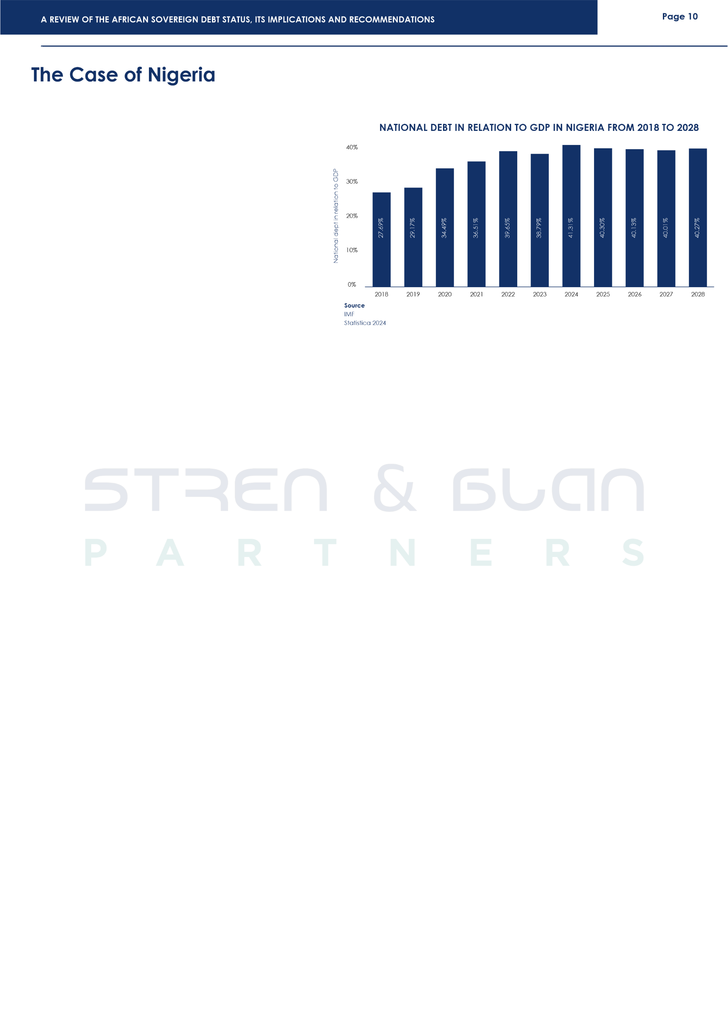
According to the Nigeria Bureau of Statistics, Nigeria's public debt stock, which includes external and domestic debt, stood at N87.91 trillion (US$114.35 billion) in Q3 2023 from N87.38 trillion (US$ 113.42 billion) in Q2 2023, indicating a growth rate of 0.61% on a quarter-on-quarter basis.²⁷ Because interest arrears build up over time and result in a larger national debt load, Nigeria's inability to efficiently satisfy her debt commitments has a negative impact on the country's economy. A larger percentage of the country's income is now allocated to debt service arrears.²⁸ Nigeria was reported to have spent 96.3% of its revenue on debt servicing in 2022, with the constant fiscal deficit worsening the country's public debt stock. it is without gainsaying that debt servicing crowds out investment and growth, and an economy where growth and investment is hampered is a failing economy.
Nigeria's high debt profile is a result of many reasons, which are government expenditure, dwindling oil prices, borrowing at non-concessional interest rates, and dependence on imports.²⁹ Additionally, there are issues such as corruption, political rascality, mismanagement, and waste. There are also policy issues such as adverse interest and exchange rate management policies, etc. Evidently, one of the reasons for the instability of the Nigerian economy is its debt burden, which it services with over 50% of its revenue.
Cumulative Implication of These Debts to the African Continent
The African continent is home to 1.4 billion people, making up one-sixth of the world's population. The importance of this region in the global economy cannot be overemphasized, particularly due to its burgeoning and youthful population, the abundance of natural resources vested in this region, and its strategic location.³⁰ Hence, long-term investment in physical and social infrastructure and political will, in the minds of various leaders within the region, will help lift millions out of poverty. According to UNCTAD, Africa's importance as a global economy is growing. However, the rising debt in the continent has constrained growth and limited investment and development in many African countries.³¹ The escalation of debt in Africa cannot be solely attributed to the conflict in Europe. The imperative to acquire personal protective equipment (PPE), pharmaceuticals, medicines, vaccines, and other essential goods during the COVID-19 pandemic played a significant role in driving up debt levels across the continent. Due to the frequency with which African countries have been borrowing in recent years, the debt level has risen. an increasing problem for all income groups in African countries.
²⁷Nigeria Beaurue of Statistics, "Nigerian Domestic & Foreign Debt Q2 2023", (September 2023) accessed 14 December 2023.
²⁸Audu, I. "The impact of External debt on Economic growth and Public Investment: The case of Nigeria. African Institute of Economic Development and Planning Dakar Sengal: (IDEP)" (2004) accessed 14 December 2023.
²⁹Central Bank of Nigeria, “Payment System” accessed 14 December 2023.
³⁰Amin Mohseni-Cheraghlou, “Reimagining Africa’s role in revitalizing the global economy”, ( October 9, 2023) accessed 14 Decemebr 2023.
³¹UNCTAD, “A World of Debt” accessed 14 December 2023.

Slide 12

Cumulative Implication of These Debts to the African Continent
Africa is in its current position because of the buildup of increasingly expensive debt in a difficult economic climate, with some governments unable to make their debt repayment obligations. The cost of debt has increased along with the rise in indebtedness, as interest rates have risen in the context of the battle against inflation.³² The debt burden within the region affects economic growth and stability, thus investors and governments must pay close attention to this issue.
However, in the absence of positive actions towards restructuring the external debt of several African countries, it is expected that these countries will feel a financial squeeze as result of the heavy debt repayment obligations in 2024. Zambia's ongoing attempt at restructuring its debts amidst disagreements between its official creditors and private creditors has increased pressure on the country's economy, it is hoped that 2024 will see a successful resolution of its debt restructuring negotiations with its creditors.
Ghana's successful domestic debt restructuring operation and reforms helped achieve the approval of the IMF Executive Board of a US$3 billion) 36-month Extended Credit Facility (ECF) arrangement for the Country in May, 2023, allowing for an immediate pay out of roughly $600 million, this was followed by the staff-level agreement on economic policies and reforms to conclude the first review of the 36-month ECF-supported program, which will enable Ghana have access to about US$600 million in financing once the review is approved by IMF Management and formally completed by the IMF Executive Board. According to the IMF to ensure timely completion of the review, the country needs official creditors to quickly reach agreement on a debt treatment in line with the financing assurances they provided in May 2023. Therefore, in 2024 it is expected that under the forum of the Common Framework Ghana and its official creditors will be reaching a debt treatment agreement with the aim being to restore macroeconomic stability and debt sustainability while laying the foundation for stronger and more inclusive growth.
2024 OUTLOOK
It is clear from examining the sovereign debt position of a few African nations and its ramifications, that the continent's economic stability and expansion are seriously threatened by the rising debt levels. The financial burden on African countries has increased because of the Covid-19 pandemic, necessitating the development of long-term, strategic plans to manage and lower government debt. Notwithstanding the current state of sovereign debt in Africa, experts have predicted that amidst its financial woes, Africa will be the second-fastest-growing major region in 2024, with most countries posting an acceleration of economic growth compared with 2023.³³
³²Coface, “Debt sustainability in Africa under the spotlight again”, (July 12, 2023) accessed 14 December 2023.
³³The Economist Intelligence Unit “Africa outlook 2024 Strong growth amid heated elections and financial woes” 2023.

Slide 13
Page 12
According to Fitch, Kenya's external financing requirement is set to rise FY24 in part due to its scheduled buy back of USD $2 billion Eurobond due in June of 2024. Kenya is presently faced with the task of preventing a default on its obligation to avoid a damage to its financial reputation. The country's target is to scale through the 2024 payment deadline which will grant it financial respite ahead of its next eurobond payment of $1.9 billion due in 2027-28.
A positive from East Africa is the $4.5 billion debt forgiveness granted to Somalia by the International Monetary Fund under the Heavily Indebted Poor Countries Initiative, or HIPC. After years of reform the country finally completed the HIPC process which led to the debt relief. Now, considering the lingering debt crisis some countries may embark on debt restructuring in 2024 and these include Ethiopia, Malawi, Mozambique, Sudan and Zimbabwe.
By implementing prudent strategies and fostering responsible financial practices, these African Countries can navigate the challenges associated with sovereign debt and pave the way for long-term stability and growth. A cornerstone of effective debt management lies in the implementation of comprehensive economic reforms. As earlier recommended, diversifying economies beyond dependence on a limited range of sectors is crucial for building resilience to external shocks.
It should also be noted that regularly conducting debt sustainability analyses is a proactive measure to assess the impact of current and potential future debt levels. This analysis serves as a guide for making informed borrowing decisions and formulating debt management strategies that align with the country's long-term fiscal health.
Collaborating with international organizations, such as the International Monetary Fund (IMF) and the World Bank, offers countries financial assistance, technical expertise, and invaluable policy advice. International cooperation can also involve participation in debt relief programs, providing relief for nations facing challenges in servicing their debt. The IMF and World Bank launched the Heavily Indebted Poor Countries (HIPC) Initiative in 1996 to ensure that no poor country faces an unmanageable debt burden. In 2005, to accelerate progress toward the 'United Nations Sustainable Development Goals, the HIPC Initiative was supplemented by the Multilateral Debt Relief Initiative. This allows countries completing the HIPC Initiative process to receive 100 percent relief on eligible debts by the IMF, the World Bank, and the African Development Fund. In 2007, the Inter-American Development Bank provided additional (“beyond HIPC”) debt relief to the five HIPCs in the Western Hemisphere.³⁴
Looking ahead, the outlook for African sovereign debt management requires a multi-pronged approach. Governments and international financial institutions, such as the International Monetary Fund (IMF) and the World Bank, need to collaborate on tailored strategies to address the unique challenges faced by each nation. Key considerations include economic reforms, improved governance and transparency, responsible borrowing practices, and debt restructuring where necessary. Governments are encouraged to identify and promote sectors with high growth potential, improve the overall business environment, and foster innovation to stimulate economic diversification.
³⁴List of Countries that have qualified for, are eligible or potentially eligible, and may wish to receive HIPC Initiative assistance (as of January 2023.

Slide 14
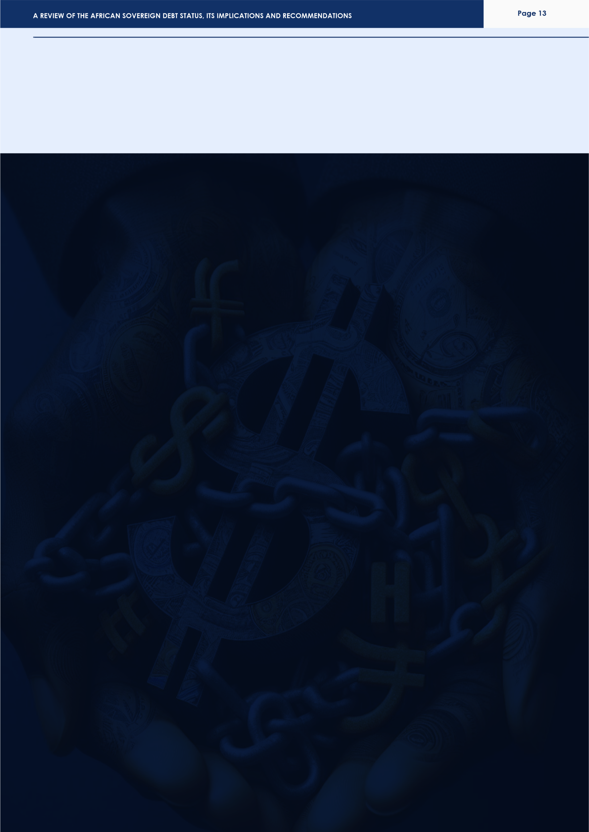
In conclusion, navigating the complexities of sovereign debt requires a multifaceted approach. By embracing these strategies, African countries can fortify their financial foundations, fostering an environment conducive to sustainable economic development and prosperity. It is through these initiatives that nations can effectively manage their debt and chart a course towards a stable and resilient economic future.
Further Considerations
With rising debts and inflation, coupled with a lack of facilities to finance these debts, the countries discussed above, and other countries in the region should opt out of pursuing more loan financing programmes and begin to look inward to resolve this problem. Hence, some of the strategies that should and can be applied are:
1. Reduction in government operation cost: In all the countries discussed above, one of the major sectors that consumes a lot of money is the exorbitant government expenditure. For example, in Nigeria, the government spends a lot of money on purchasing SUVs, private jets, etc. According to Akinwumi Adesina, president of the African Development Bank (AFDB), the cost of governance in Nigeria is very high, and there needs to be a leash on government spending, channelling such funds to human capital development, and other sectors like educational sector. Similarly, in South Africa, government spending has been said to be out of touch with the country's economic realities. This is the case for most African nations that have sovereign debt problems.
2. Tax policies and law: Instead of resolving to take loans, it is important that governments of various African countries begin to explore the possibilities of generating funds internally. Tax policies and laws are one of the most efficient ways to do this. The law is an instrument of social engineering; thus, the government can raise necessary funds for projects it intends to embark on through tax laws. Advanced nations of the world, like the US, UK, etc, apply this strategy to raise funds for the government. But it must be emphasised that you can only tax a population you have empowered, thus, reducing government expenditure and challenging the bulk of the government budget into human capital development and investment in social infrastructure will help increase a country's tax net.
3. Diversification of Economy: It is important that the economy of most African countries is not reliant on just one export. Just as in the case of Nigeria where the failing prices of oil globally ran into economic problems. Or Sudan whose GDP was 95 percent reliant on oil is South Sudan, and upon secession ran into economic problems. Hence it is important that efforts are made to diversify the economy of each African country.
4. The presence of political will amongst leaders: With the right political will, leaders will ensure that the available government funds are utilized properly. Most nations in Africa battle the hydra-headed monster called corruption. Corruption is responsible for economic instability in the region and plays a crucial role in why many nations in Africa keep borrowing. The presence of political will in leadership is a direct remedy to this issue.
Additionally, the issue of political will also extends to political instability. Political instability in the region, especially in East Africa is because of disagreements amongst the leaders. Where there is political will, leaders will begin to think about the nation as a whole and not about themselves.

Slide 15




Amala Umeike
Partner
amalaumeike@strenandblan.com
Omobolaji Bello
Associate
omobolajibello@strenandblan.com
Sopuruchi Rufus
Associate
sopuruchirufus@strenandblan.com

